Slide 1

Department
Presents
Standard Form

Slide 2
Mental Maths
Q1. Is 4 greater than 0.02 ?
Q2. Is 0.2 less than 0.02 ?
Q3. Name a real life example where a very large number and a very small number could be expressed in Standard Form ?

Slide 3
Topic: Standard Form
EQ: How do I convert between decimal and scientific numbers / notation ?

Slide 4


Slide 5
How big ?
First let’s check are understanding of very large and very small numbers.
The Cosmic Eye.
https://www.youtube.com/watch?v=jfSNxVqprvM

Slide 6
Activity 1 part 1 Estimating distance
Outdoor Activity;
First mark a start point with a peg .
Then estimate a distance of 10 metres from this point. Mark your estimate with a coloured counter that has you name on.
Then mark with another counter your estimate of 1 metre from the start.
Finally mark with a counter a distance of 10 cms from the start.

Slide 7
Activity 1 part 2 Measuring distance
Outdoors Activity;
First mark a start point with a peg .
Then measure a distance of 10 metres using a tape measure or measuring wheel and peg a second mark exactly 10 metres.
Then mark with a peg a distance of 1 metre from the start.
Then mark with a peg a distance of 10 cms from the start.

Slide 8
How does this activity help with my understanding of decimals and scientific notation?
The activity should have given you a better idea of scale and size.
If we now convert all the distances to mm we will get some pretty large numbers.
Have a go and check your answers.
Is there a way we could represent these numbers differently?

Slide 9



Very large numbers!
BOOM!
How far?
92,000,000 miles

Slide 10
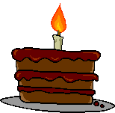


Very large numbers!
Happy 70th Birthday!
SPLAT!
How many seconds in 70 years?
70 years = 2 200 000 000 seconds!

Slide 11



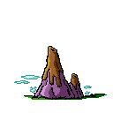
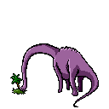
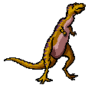
Very large numbers!
Dinosaurs roamed the earth 228 million years ago

Slide 12



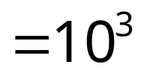



Short hand!
10
100 = 10 x 10
1 000 = 10 x 10 x 10
10 000 = 10 x 10 x 10 x 10
100 000 = 10 x 10 x 10 x 10 x 10
1 000 000 = 10 x 10 x 10 x 10 x 10 x 10

Slide 13
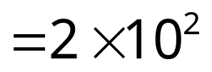
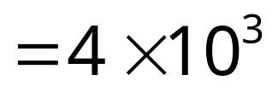
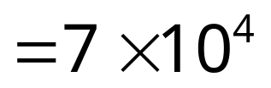
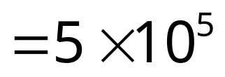
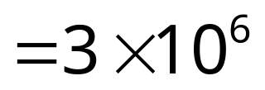


Standard Form
200 = 2 x 100
4 000 = 4 x 1000
70 000 = 7 x 10 000
500 000 = 5 x 100 000
3 000 000 = 3 x 1 000 000
This is also known as
Scientific Notation.

Slide 14
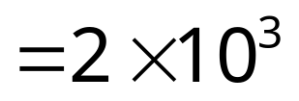
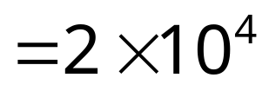
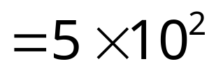
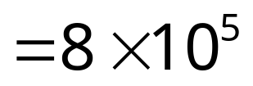

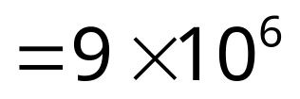
Exercise 1
2 000
(2) 20 000
(3) 500
(4) 800 000
(5) 9 000 000
= 2 x 1000
= 2 x 10 000
= 5 x 100
= 8 x 100 000
= 9 x 1 000 000

Slide 15
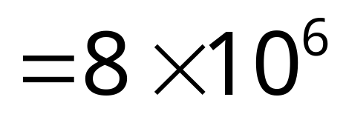
A short cut
Move the point to get a
number between 1 and 10
.
The point moved 6 places
8 000 000
.
Add the
decimal point
Between 1 and 10

Slide 16
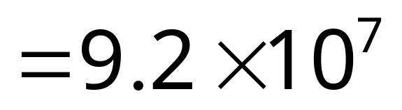
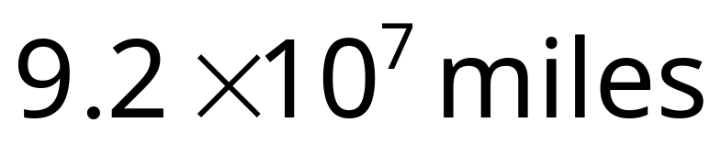
A short cut
Move the point to get a
number between 1 and 10
92 000 000
.
The point moved 7 places
.
Add the
decimal point
Between 1 and 10

Slide 17
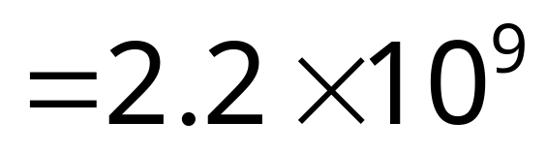
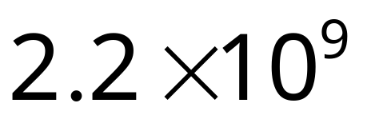

A short cut
Move the point to get a
number between 1 and 10
2 200 000 000
.
The point moved 9 places
.
Add the
decimal point
Happy Birthday: Seconds old!
Between 1 and 10
SPLAT!

Slide 18
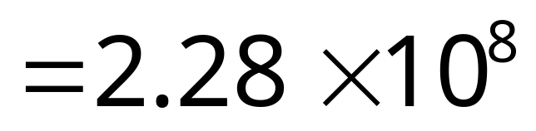
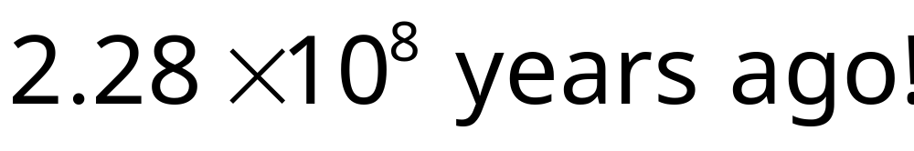
A short cut
Move the point to get a
number between 1 and 10
228 000 000
The point moved 8 places
.
.
Add the
decimal point
Between 1 and 10

Slide 19










Exercise 2
(1) 30 000
(2) 700 000
(3) 5 300
(4) 470 000
(5) 9 500 000
(6) 18 300 000
(7) 329 000
(8) 2 560 000
(9) 12 000 000 000
(10) 9 990 000

Slide 20
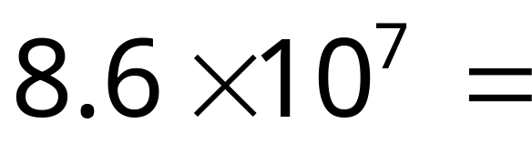
Changing back
The point moves 7 places
8.6
0000000
.
=86 000 000
Hint:
Add 7 zeros, although you probably won’t need them all.
Zeros after the point aren’t needed.

Slide 21
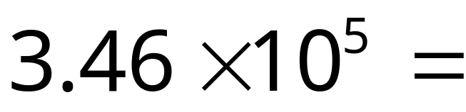
Changing back
The point moves 5 places
3.46
00000
.
=346 000
Hint:
Add 5 zeros, although you probably won’t need them all.
Zeros after the point aren’t needed.

Slide 22










Exercise 3
(1)
(2)
(3)
(4)
(5)
(6)
(7)
(8)
(9)
(10)
= 600 000
= 8 000
= 650 000
= 120 000 000
= 3 710 000
= 33 000
= 7 910 000
= 55 500 000
= 10 500
= 3 033 000 000

Slide 23

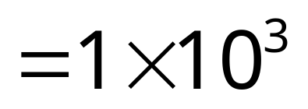
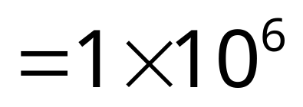
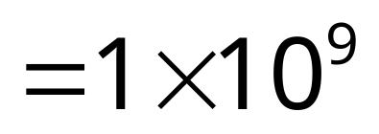
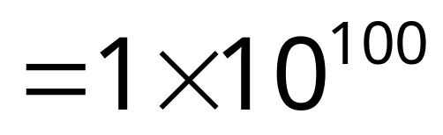
Name that number!
1 000
one thousand
What’s this called?
1 000 000
one million
What’s this called?
1 000 000 000
and this one?
one billion
10 000 000 000 000 000 000
000 000 000 000 000 000 000
000 000 000 000 000 000 000
000 000 000 000 000 000 000
000 000 000 000 000 000
one googal !!!
What’s this called?

Slide 24
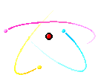
Very small numbers!
How wide is an atom?
0.000 000 000 1 metres wide!

Slide 25
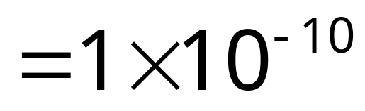
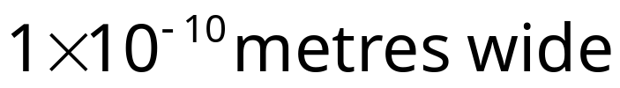
Standard Form for small numbers
Move the point to get a
number between 1 and 10
0.000 000 000 1
.
The point moved 10 places. Negative sign for small numbers.

Slide 26
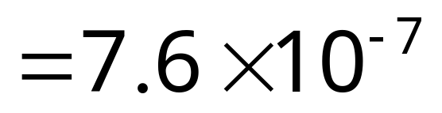
Standard Form for small numbers
Move the point to get a
number between 1 and 10
.
0.000 000 76
The point moved 7 places. Negative sign for small numbers.

Slide 27
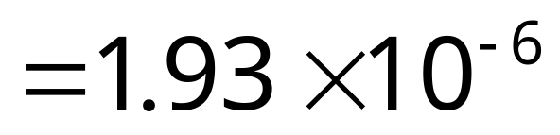
Standard Form for small numbers
Move the point to get a
number between 1 and 10
0.000 001 93
.
The point moved 6 places. Negative sign for small numbers.

Slide 28










Exercise 4
(1) 0. 000 3
(2) 0.000 07
(3) 0.000 45
(4) 0.003 4
(5) 0. 000 724
(6) 0.000 000 494
(7) 0.000 095
(8) 0.000 000 098
(9) 0.000 1 03
(10) 0.000 000 000 66

Slide 29
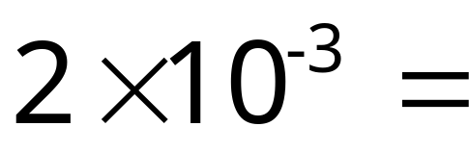
Changing back small numbers
-3 so remember to move point left for small numbers.
Hint:
Add 3 zeros to the left of the number.
000
2
.
.
= 0.002

Slide 30
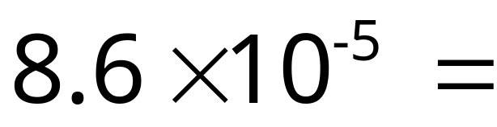
Changing back small numbers
-3 so remember to move point left for small numbers.
Hint:
Add 5 zeros to the left of the number.
00000
8.6
.
= 0.000 086

Slide 31
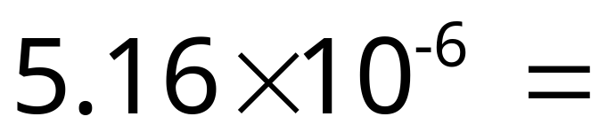
Changing back small numbers
-3 so remember to move point left for small numbers.
Hint:
Add 6 zeros to the left of the number.
000000
5.16
.
= 0.000 00516

Slide 32










Exercise 5
(1)
(2)
(3)
(4)
(5)
(6)
(7)
(8)
(9)
(10)
= 0.000 5
= 0.000 09
= 0.005 8
= 0.000 000 62
= 0.000 006 45
= 0.000 000 53
= 0.000 009 17
= 0.002 12
= 0.000 020 3
= 0.000 000 006 032

